Slide 1




2016 Annual Event ‘’H2020 NCPs Training’’
Minsk, 16-17 March 2016
Project Management and Implementation
George Bonas
Managing Director
CeRISS, Greece
IncoNet EaP is a project funded under
the 7th European Framework Programme
for research - Project number 609528

Slide 2
Grant Agreement Preparation Phase
The importance of Grant Agreement Preparation Phase
gather legal, administrative and financial information from all prospective beneficiary (project participant)
make sure the Description of the Action (DoA, Annex 1 to the grant agreement) and the Estimated budget for the action (Annex 2) match the proposal, any relevant information in the invitation to prepare the grant agreement, and the ethics review report or/and the security scrutiny report
establish the key points of the grant agreement (when the project starts, reporting periods, amount of pre-financing, need for consortium agreement, and, if applicable, ethical issues, third parties linked to the beneficiaries, in-kind contributions provided by third parties, subcontracting)
verify the financial capacity (principally, this concerns certain types of coordinators only, other participants will be check in exceptional cases)

Slide 3

Grant Agreement Preparation Phase
When a H2020 proposal is successful..
-The Coordinator of the consortium receives the 'Evaluation Summary Report‘ and the Letter/ Invitation for the grant preparation phase.
-An EC Project Officer is assigned to be responsible for the preparation phase
3 weeks after: deadline for the submission of the grant agreement data, including annexes. The Coordinator needs to indicate changes/amendments, if any, in the future Description of the Action (Annex 1 of the future Grant Agreement) and justify the reason(s).
5 weeks after: Following the assessment of the submitted version of the grant agreement data (by the EC PO), Coordinator will have to submit the final version taking into consideration all requirements highlighted by the Project Officer.
6 weeks after: deadline for the electronic signature of the participants’ declarations of honour.
7 weeks after: deadline for all consortium partners (LEAR) to electronically sign the grant agreement on behalf of their entity.

Slide 4
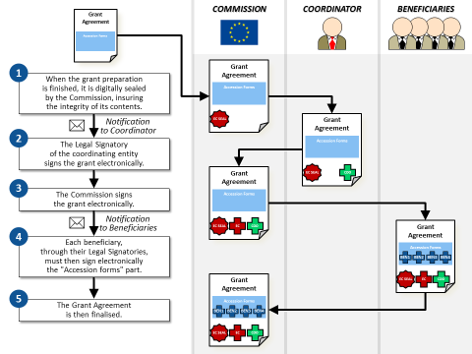
Grant Agreement Preparation Phase

Slide 5
Grant Agreement Preparation Phase
Remarks
Failure to respect the deadlines indicated will be considered as a wish not to enter into, or continue with, the grant preparation and, therefore, to withdraw your proposal
The entire grant preparation process, including communication with the Commission and the subsequent signature of the Grant Agreement , shall be carried out EXCLUSIVELY through the Participant Portal Grant Management Service (PP GMS).
Some information related to the legal and financial status of participants is read-only and may only be updated by the Legal Entity Appointed Representative (LEAR) of the concerned entity (E.g. Declaration of honour, signature of grant agreement)
Further information: H2020 Online Manual on the Participant Portal

Slide 6
Grant Agreement Preparation Phase
Important “Roles” and Participant Portal User Rights for the Grant Agreement Preparation Phase;
For the coordinating organisation:
- Primary coordinator contact (PCoCo)
- Legal entity appointed representative (LEAR)
- Project Legal signatory (PLSIGN)
For other beneficiaries:
- Participant contact (PaCo)
- Legal entity appointed representative (LEAR)
- Project Legal Signatory (PLSIGN)

Slide 7
Coordination of Consortium
The Coordinator of a Consortium : submits the proposal in the name of the consortium. Possible distinction: Scientific and Administrative/Financial Coordinator.
Main roles in the name of the consortium;
Grant agreement preparation
Overall Project Management
Read-write-submit rights to information, documents and forms in the PP.
Monitoring of the project`s implementation
Contact with the European Commission

Slide 8
Work Package/Task Management
GANTT CHART

Slide 9
Work Package/Task Management
PERTT GRAPH

Slide 10
Work Package/Task Management
Each Work Package aims to implement one or more of the project`s objectives.
Work Package Description should include;
information on the methodology for the implementation of activities;
quantified information in order to monitor the progress;
enough detail to justify the proposed resources to be allocated;
resources should be in line with their objectives and deliverables;
The number of work packages should be proportionate to the scale and complexity of the project.
Task Leader is responsible for the implementation of the activities within the Task and almost always for the timely preparation of the Deliverable (Deliverable Leader).
Deliverables are the outputs to be produced under a certain Project`s activity.
Milestones are actions in the project during which important decisions are made.
Dissemination (sharing research results with potential users - peers in the research field, industry, other commercial players and policymakers) and exploitation (using results for commercial purposes or in public policymaking).

Slide 11
Financial/Resources Management
Keeping records
Beneficiaries must keep records and other supporting documents in order to prove the proper implementation of the Project.
Administrative Records
Consortium agreement (and amendments)
Grant agreement (and amendments)
Scientific Records
Progress reports
Records of meetings (Agendas, LoP)
Financial Records
Direct costs are directly linked to the activities in the project, such as;
Personnel costs (Time sheets)
Travel costs (Tickets/ Hotel invoices/ Boarding Pass/ Invitation Letter/ Agenda)
Equipment (Depreciation)
Subcontracting (major/minor)
Indirect costs (or Overhead) cannot directly linked to the activities in the project, such as;
photocopies
Phone bills, heating, electricity etc.

Slide 12
Reporting (Technical)
The Reports are structured in Work Packages.
Only electronic submission
Two types of reporting;
Continuous Reporting: Deliverables, Amendments etc.
Regular Reporting:
Progress report (within 30 days after year 1,NO financial),
Periodic report (Technical report overview: progress, achievements, differences from work plan + Continuous reporting, Financial report - Individual financial statement from each beneficiary + Periodic summary financial statement) ‘’Explanation of use of resources’’
Final report (within 60 days of the end of the final reporting period- covers whole project period: Final technical report (publishable summary of the entire project which includes overview of the results and their exploitation and dissemination, conclusions, socio-economic impact of the project), Final financial report (final summary financial statement created automatically by the electronic exchange system, consolidating the individual financial statements for all reporting periods)

Slide 13
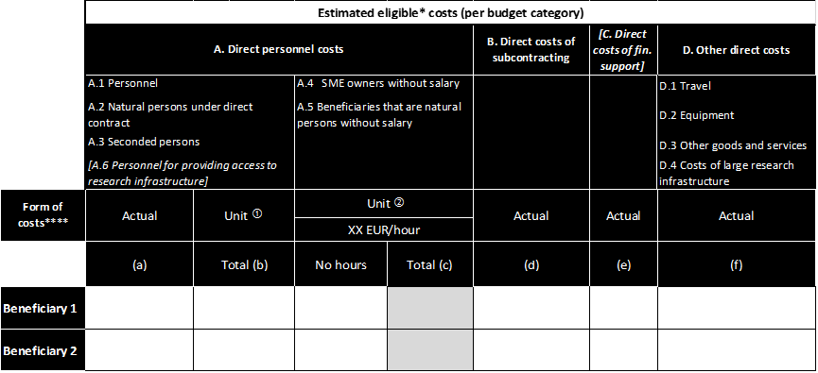
Reporting (Financial)
The Report is structured in Work Packages.
Only electronic submission
Form C

Slide 14
Reporting (Financial)
Form C Contents;
Direct personnel costs/Labour
Other direct costs /Travel, Other
Direct costs of subcontracting/Subcontract
Indirect costs
Remarks
→VAT is not an eligible cost
→Unique flat rate of 25% for indirect costs
→Individual financial statement from each Beneficiary

Slide 15


Thank you for your attention!
George Bonas
Managing Director
CeRISS, Greece

